Slide 1


Target Market:- People on a budget or on vacation who want to utilize products temporarily for their needs.
Team Members:-
1. PULKIT KHURSIJA
2. ANIL KUMAR
3. SRI SANTHI
4. PRAVEEN PINDI
5. SHIVA REDDY
Value propositions:-
Easily renting anything and everything from your neighborhood. An idea that will help to reduce the purchase of occasionally use products.

Slide 2

Key Winning Features
Map pin dropping for items.
Secure communication between two parties using emails.
Encryption of personal data on the database for enhanced security C to C business model.
Proper classification of items based on their category.
Easy and simple to use interface.
Non- Complicated site maps for easy navigation.
Current and future availability of items on rent.
Time stamping.
Products are easily accessible.
No commission of sale/ Purchase of commodity by the company for the users.

Slide 3

Justification
Product will easily be used over lower internet speeds.
Product can be accessed from areas with lower bandwidthThe C-to-C business model.
The problem of occasional use products and expensive products for short time use will be solved efficiently and within your neighborhood.
Pick and drop locations for items.
Sorting of products.

Slide 4

Justification
Products that are most often and seldom used : Mowing Tools, Wood Workings, Fishing Equipment, Traditional Clothes, Musical Instruments, Books, Camping Gears & Automobiles etc.
Owners may rent out things they don't use much or have extras of. It will also help those who are looking for things but only need them for a short time.
With this method, owners may sell objects that accumulate dust in their houses and earn money.
The website will also be able to filter items by proximity.
In terms of application, our website is similar to Facebook's marketplace and an Indian website named OLX(sell used products), but our website is different in its applicability (rent products )

Slide 5
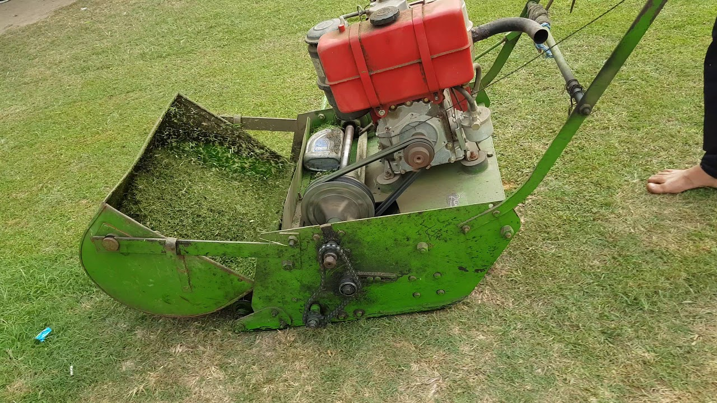


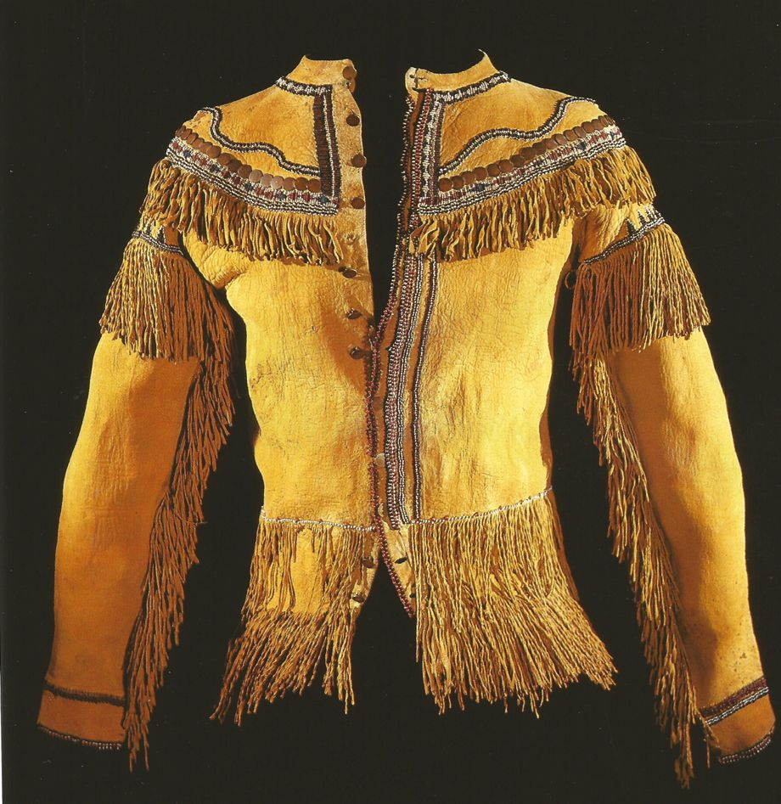
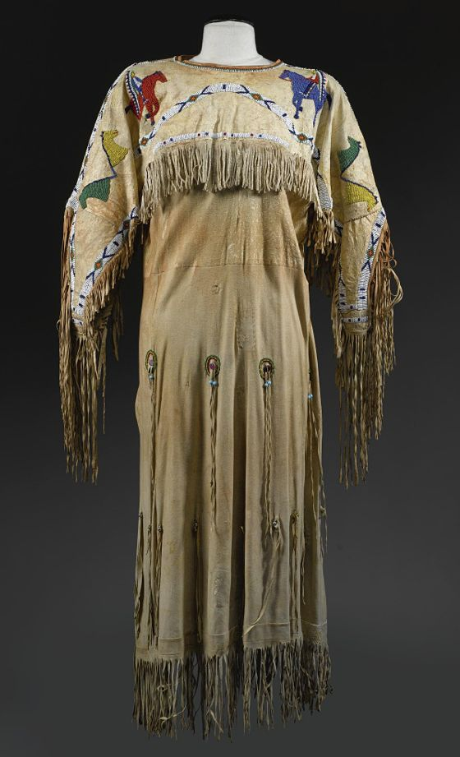
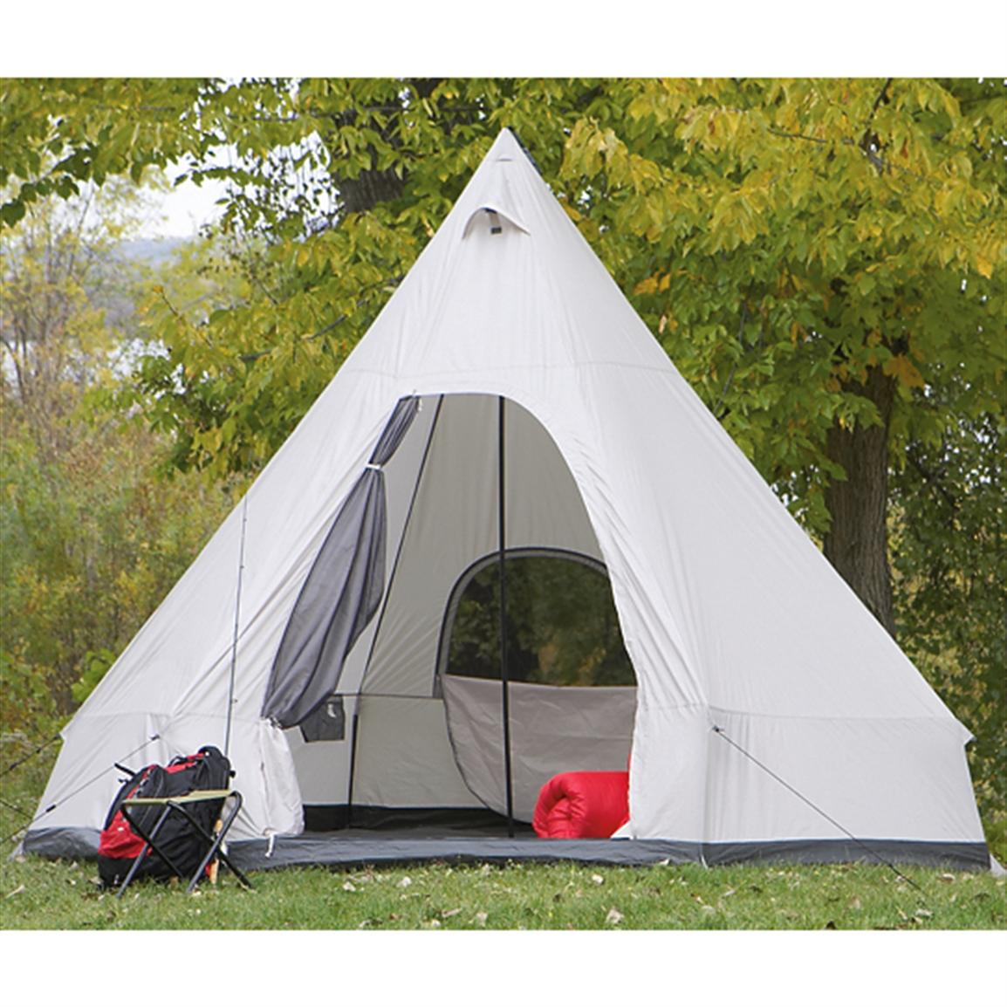

Key Products

Slide 6

Capabilities
Works on google Firebase database.
Website will be able to handle approximately 8-10 current categories of distinguished items.
Either of Usernames or emails can be used to signup/sign-in.
Built on firebase platform.Small size of website.

Slide 7

Conclusion
The primary objective of this program is to create a user-friendly platform for rental services. With the use of our application (the Ez-Renting website), we will rent products to consumers who need them for a short amount of time but who are unable to purchase these items since they are only necessary for a short period of time.

Slide 8

Implementation plan
Design User Interface & Backend
Data Gathering & Identifying Key Features
Development, Implementation of Features
Testing and Validation
Deployment & Documentation

Slide 9
Thanks

